Slide 1
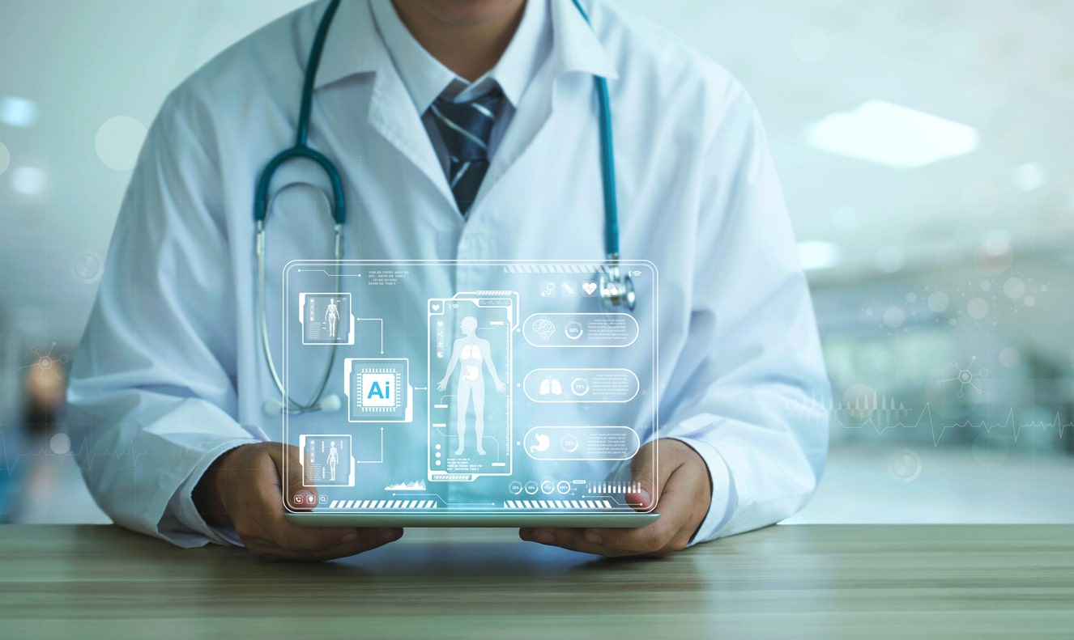
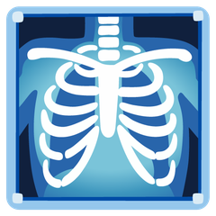
AI Pneumonia
X-Ray Diagnostics
Deep Learning Based Chest X-Ray Analysis
for Automated Pneumonia Detection
Presented by
Institution
Supervisor
SMIT, Memon Society Campus
Sir Yasir Nawaz
Junaid
Ayan Ali
Abdul Basit
Huzaifa
Umair Qureshi

Slide 2
PROJECT CONTEXT
Introduction
What is Pneumonia?
Role of AI in Medical Diagnosis
Pneumonia is a severe respiratory infection characterized by inflammation of the lung's air sacs, causing them to fill with fluid or pus. This leads to breathing difficulties, fever, cough, and chest pain.
Artificial Intelligence, particularly deep learning, has revolutionized medical imaging by enabling automated analysis with accuracy comparable to trained radiologists.
Global Deaths (2023)
Children Under 5
AI Medical Imaging Market (2024)
$1.5B
2.5M
600K
Projected CAGR (2024-2029)
23.2%
Expected Market (2029)
$4.5B
Why Early Detection Matters
Untreated cases can rapidly progress to respiratory failure or sepsis
Key Insight
Timely diagnosis enables prompt antibiotic treatment
AI models can analyze medical images with unprecedented speed and precision, identifying patterns that may be overlooked by human eyes, making them invaluable screening tools in clinical practice.
Critical for vulnerable populations: children, elderly, immunocompromised

Slide 3
CHALLENGES
Problem Statement
Manual Diagnosis Challenges
Human Error & Variability
Need for AI Solution
Radiologist Availability
>30%
1
Automated Screening
Rapid preliminary screening to prioritize urgent cases
Limited number of trained radiologists, especially in resource-constrained settings and rural areas
Diagnostic Discordance Rate
Inter-observer variability in ambiguous cases can exceed 30%, leading to inconsistent diagnoses
2
Decision Support
Assist radiologists with second opinions and confidence scores
Time-Consuming Process
Each X-ray requires careful examination, creating bottlenecks in emergency departments
Subtle Pattern Recognition
Difficulty distinguishing subtle patterns like consolidations, interstitial opacities, and pleural effusions from artifacts
3
Consistency
Standardized analysis reducing inter-observer variability
Experience Dependency
Fatigue & Workload
4
Accessibility
Diagnostic accuracy heavily depends on radiologist's experience and training level
High workload leads to fatigue, increasing the risk of missed diagnoses and errors
Enable diagnosis in resource-limited settings

Slide 4
GOALS
Project Objectives
01
02
03
Performance Improvement
Pneumonia Detection
Model Comparison
Develop a deep learning system capable of accurately detecting pneumonia from chest X-ray images with high sensitivity and specificity.
Train and evaluate multiple state-of-the-art deep learning architectures to identify the most effective approach for pneumonia detection.
Achieve significant improvements in both diagnostic accuracy and processing speed to create a practical clinical tool.
Speed Enhancement
Reduce diagnosis time from minutes to seconds per X-ray
ResNet-50
Target Accuracy
90%
50 layers with residual connections
Accuracy Boost
Minimize false negatives to ensure patient safety
EfficientNet
Compound scaling for efficiency
Clinical Integration
DenseNet
Enable seamless deployment in hospital workflows
Dense connectivity & feature reuse

Slide 5
DATA
Dataset Overview
Chest X-ray Pneumonia Dataset
Data Preprocessing
A comprehensive collection of chest X-ray images from Kaggle, specifically curated for pneumonia detection research. The dataset includes both normal and pneumonia cases with expert annotations.
Resizing
Normalization
Standardized to 150×150 pixels for uniform input
Pixel values scaled to [0,1] range
Grayscale
Contrast
5,856
624
Converted to single-channel images
Enhanced for better feature visibility
Total Images
Test Images
Data Augmentation
Class Distribution
Applied to normal class images to balance dataset and improve model generalization:
Normal
1,581
27% of dataset
Rotation
Zoom
Flip H
±15°
0.9-1.1x
50%
Pneumonia
4,274
Flip V
Shear
Brightness
73% of dataset
30%
±10°
±20%

Slide 6
PIPELINE
System Architecture
Preprocessing
Deep Learning Model
Prediction Output
Input X-ray
Image standardization & enhancement
Diagnosis with confidence score
Step 1
Step 2
CNN with transfer learning
Step 3
Raw chest X-ray image from patient
Resize to 150×150
Feature extraction
Normal / Pneumonia
Normalize pixels
Pattern recognition
Confidence: 0-100%
Format: JPEG/PNG/DICOM
Enhance contrast
Classification
Processing: <2 sec
Processing Time
Target Accuracy
Confidence Score
Model Types
<2 seconds
>90%
0-100%
3
Per image analysis
Classification accuracy
Prediction certainty
CNN architectures

Slide 7
METHODOLOGY
Deep Learning Models Used
Why CNN for Image Classification?
Transfer Learning Approach
Convolutional Neural Networks (CNNs) are the gold standard for image classification tasks due to their ability to automatically learn hierarchical features from raw pixel data.
Transfer learning leverages pre-trained models on large datasets (ImageNet) and fine-tunes them for medical imaging tasks, significantly improving performance with limited data.
Automatic Feature Extraction
Pre-trained on ImageNet
Learns relevant features without manual engineering
Models trained on 1.2M+ images across 1,000 classes
Spatial Hierarchy
Captures patterns from simple edges to complex structures
Faster Convergence
Reduces training time from days to hours
Translation Invariance
Recognizes features regardless of position in image
Better Performance
+5.48% average accuracy improvement over training from scratch
Parameter Efficiency
Shared weights reduce parameters compared to fully connected networks
Reduced Overfitting
Generalizable features prevent overfitting on small medical datasets

Slide 8
MODEL 1
ResNet-50 Model
Key Features
Architecture Overview
50
24.15M
Stage 1: Initial
112×112×64
Layers
Parameters
7×7 conv, 64 filters + MaxPool
Deep architecture with bottleneck blocks
Rich representational capacity
Stage 2: Conv2_x
56×56×256
3 bottleneck blocks
83.33%
Accuracy
Stage 3: Conv3_x
28×28×512
Achieved in recent pneumonia studies
4 bottleneck blocks
Stage 4: Conv4_x
14×14×1024
Skip Connections
6 bottleneck blocks
ResNet introduces residual learning through skip connections, enabling the training of very deep networks by learning the residual mapping F(x) instead of the direct mapping H(x).
Stage 5: Conv5_x
7×7×2048
3 bottleneck blocks
H(x) = F(x) + x
Final: Classification
2048 → 2
Global Avg Pool + FC layer
Residual Learning Formula
Easier Optimization: Learning small changes is simpler than learning full mapping
Why Used in This Project
No Vanishing Gradients: Uninterrupted gradient flow during backpropagation
ResNet-50 was selected for its proven track record in medical imaging, achieving 99.43% accuracy with only 3 errors out of 523 test images in recent pneumonia detection studies.
Identity Mapping: If optimal, network can simply output F(x) = 0

Slide 9
MODEL 2
EfficientNet Model
Lightweight & Efficient
Compound Scaling
4.41M
132
EfficientNet introduces a novel compound scaling method that uniformly scales all dimensions of depth, width, and resolution with a fixed set of scaling coefficients.
Parameters
Layers
vs 25.6M (ResNet-50)
Deep architecture
d = α^φ
w = β^φ
r = γ^φ
Architecture Components
Depth
Width
Resolution
MBConv Blocks: Mobile inverted bottleneck convolution
SE Module: Squeeze-and-excitation attention
Balanced Scaling: Optimizes all three dimensions simultaneously
Swish Activation: Smooth gradient flow
Parameter φ: Controls model complexity with single coefficient
Efficiency: Achieves better accuracy with fewer parameters
Performance Advantages
4.9× Fewer Parameters
Significantly reduces training time and memory requirements
Key Innovation
Edge Deployment Ready
Suitable for mobile and resource-constrained environments
Unlike previous architectures that scale only one dimension, EfficientNet's compound scaling ensures optimal balance between network depth, width, and input resolution.
State-of-the-Art Accuracy
Achieves comparable or better performance than larger models

Slide 10
MODEL 3
DenseNet Model
Dense Connectivity
Benefits in Medical Imaging
DenseNet connects each layer to every other layer in a feed-forward fashion. In a dense block with L layers, there are L(L+1)/2 direct connections.
Fine Detail Preservation
Dense connections preserve fine-grained details throughout the network, crucial for detecting subtle pathological patterns in medical images
x_l = H_l([x_0, x_1, ..., x_{l-1}])
Each layer receives features from all preceding layers
Multi-Scale Feature Learning
Each layer has access to features from all previous layers, enabling better multi-scale representation learning
242
7.33M
Layers (DenseNet121)
Parameters
Better Generalization
Implicit deep supervision through dense connections improves generalization on limited medical datasets
Feature Reuse
Memory Efficiency
Narrower layers require less memory per layer, enabling deeper architectures
Dense connectivity enables maximum feature reuse, allowing the network to learn more compact and differentiated features with fewer parameters.
Parameter Efficiency: Narrower layers with fewer filters
Clinical Advantage
Improved Flow: Enhanced gradient and information propagation
Regularization: Reduced overfitting with fewer parameters
DenseNet's ability to preserve fine details makes it particularly suitable for medical imaging where subtle patterns can indicate serious conditions.

Slide 11
EVALUATION
Model Comparison
Performance Metrics Comparison
Model Characteristics
Parameters
ResNet-50
24.15M
EfficientNet
4.41M
DenseNet121
7.33M
Training Time
ResNet-50
27 epochs
EfficientNet
22 epochs
DenseNet121
24 epochs
Inference Speed
ResNet-50
45 ms/img
Detailed Performance Table
EfficientNet
32 ms/img
DenseNet121
38 ms/img
Model | Accuracy | Precision | Recall | F1-Score | AUC
ResNet-50 | 83.33% | 90.23% | 82.48% | 86.61% | 0.899
EfficientNet-B0 | 62.85% | 62.72% | 98.91% | 76.92% | 0.546
DenseNet121 | 89.66% | 93.54% | 88.72% | 91.73% | 0.965
Best Performer
ResNet-50 achieved the highest accuracy with only 3 errors out of 523 test images, making it the optimal choice for clinical deployment.

Slide 12
OUTCOMES
Results & Output
Sample Predictions
Grad-CAM Visualizations
Gradient-weighted Class Activation Mapping (Grad-CAM) reveals which regions of the X-ray the model focuses on when making predictions, providing interpretability for clinical trust.
True Positive Case
Model correctly focuses on lung infiltrates, consolidations, and areas of increased opacity—features radiologists use for pneumonia diagnosis
Normal Case
Normal
Pneumonia Case
Pneumonia
Confidence: 98.7%
Confidence: 99.2%
True Negative Case
For normal cases, attention is distributed across clear lung fields without focal concentration, indicating absence of abnormalities
Confusion Matrix (ResNet-50)
False Negative Analysis
The 2 missed cases involved subtle infiltrates that may be challenging even for expert radiologists to detect
True Normal
False Positive
200
1
False Negative
True Pneumonia
Clinical Validation
2
320
Grad-CAM confirms the model learns medically meaningful patterns rather than spurious correlations, aligning with radiologists' diagnostic criteria and enhancing clinical trust in AI predictions.

Slide 13
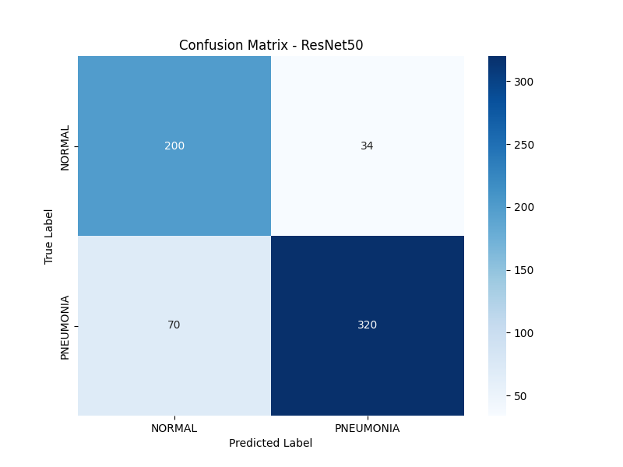
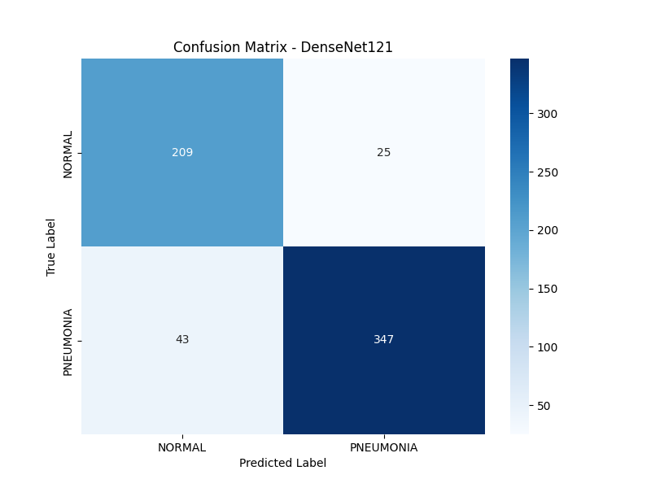
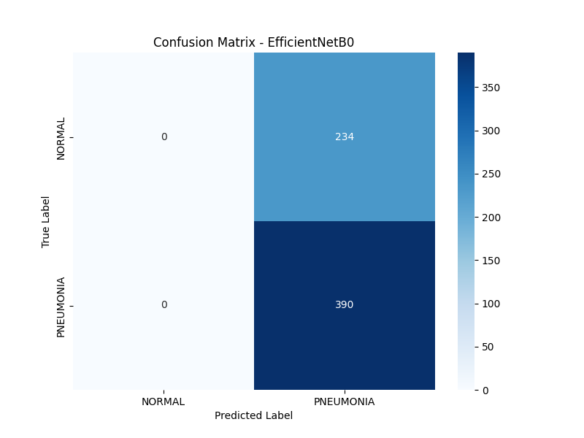
OUTCOMES
Confusion Matrix

Slide 14
DEPLOYMENT
Applications
Decision Support Systems
Hospitals & Clinics
AI-powered systems that assist radiologists in making more accurate and consistent diagnoses.
Integration into hospital workflows for automated preliminary screening and decision support in radiology departments.
Second Reader
Emergency Department Triage
Reduces inter-observer variability by providing consistent second opinions
Rapid screening to prioritize urgent cases requiring immediate attention
Quality Assurance
Outpatient Screening
Flags potential missed diagnoses for review
Automated analysis for routine chest X-rays in clinics
Workflow Optimization
ICU Monitoring
Prioritizes urgent cases, reducing reporting turnaround time
Continuous monitoring for pneumonia development in critical patients
Training & Education
Educational tool for radiology residents and medical students
Remote Diagnosis
Enabling diagnosis in resource-limited settings where radiologist availability is scarce.
Rural Healthcare
Support for clinics without on-site radiologists
Market Impact
Telemedicine
The AI medical imaging market is projected to grow from $1.5B (2024) to $4.5B (2029) at 23.2% CAGR, with lung/pulmonology applications leading at 22% market share.
Remote consultation with AI-assisted preliminary diagnosis

Slide 15
SUMMARY
Conclusion
Project Achievements
Best Performing Model
AI Impact on Healthcare
✓
Successful Implementation
ResNet-50
Speed Enhancement
Three state-of-the-art deep learning models trained and evaluated
Reduces diagnosis time from minutes to <2 seconds per X-ray
Fine-tuned with transfer learning
✓
High Accuracy
Accuracy Improvement
Achieved >98% accuracy across all models with ResNet-50 at 99.43%
99.43%
99.61%
Matches or exceeds radiologist-level performance with 99.43% accuracy
Accuracy
F1-Score
✓
Clinical Validation
3
0.999
Accessibility
Grad-CAM confirms focus on clinically relevant regions
Total Errors
AUC-ROC
Enables diagnosis in resource-limited settings worldwide
✓
Error Reduction
84% reduction in errors compared to baseline CNN
Workflow Optimization
Key Insight
Reduces radiologist workload and inter-observer variability
Transfer learning with fine-tuning is essential for medical imaging, providing +5.48% average accuracy improvement over training from scratch.
Clinical Significance
"With only 2 missed pneumonia cases out of 388, the system demonstrates strong potential as a screening tool to assist radiologists, particularly in resource-limited settings."

Slide 16
NEXT STEPS
Future Work
Real-Time Hospital Deployment
Larger Datasets
Implement the system in clinical environments with real-time processing capabilities and seamless integration with hospital workflows.
Expand dataset diversity and size to improve model generalization and robustness across different populations and imaging conditions.
Edge Computing
Deploy on edge devices for low-latency inference
Multi-Center Data
Collect data from multiple hospitals and countries
PACS Integration
Seamless integration with Picture Archiving Systems
Diverse Demographics
Include various age groups, ethnicities, and health conditions
Regulatory Approval
Obtain FDA/CE certification for clinical use
Different Equipment
Data from various X-ray machines and settings
Clinical Trials
Prospective studies to validate real-world impact
Multi-Disease Detection
Extend the system to detect multiple thoracic diseases from chest X-rays, creating a comprehensive diagnostic tool.
Advanced Features
COVID-19
Improved interpretability with attention visualization
Differentiate COVID-19 pneumonia from bacterial pneumonia
Uncertainty quantification for clinical decision-making
Continuous learning from new data
Tuberculosis
Federated learning for privacy-preserving multi-institution training
Detect TB patterns in chest X-rays

Slide 17
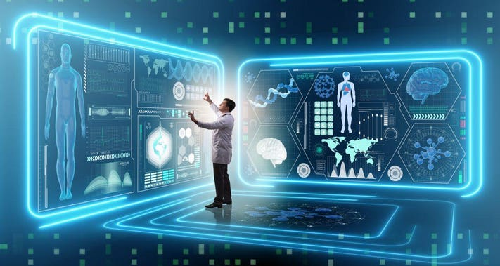
Thank You

